Slide 1
DEEP CLUSTERING
Teaching and Learning Seminar
Maryleen Ndubuaku (PhD Candidate)
Supervised by Prof Antonio Liotta
Data Science Research Centre
Department of Electronics and Computing
University of Derby, UK
Notes:
My research is focusing on real-time anomaly detection in video…this is technique I am currently investigating to achieve

Slide 2
Learning outcome
Refresher on clustering [goals + techniques]
How deep learning improves clustering and why it works
Applications
Limitations of state-of-the-art and open questions

Slide 3
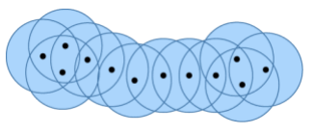
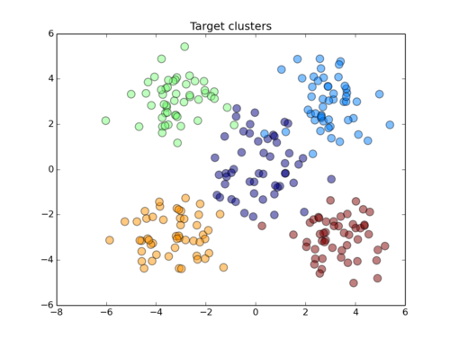
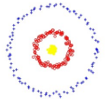
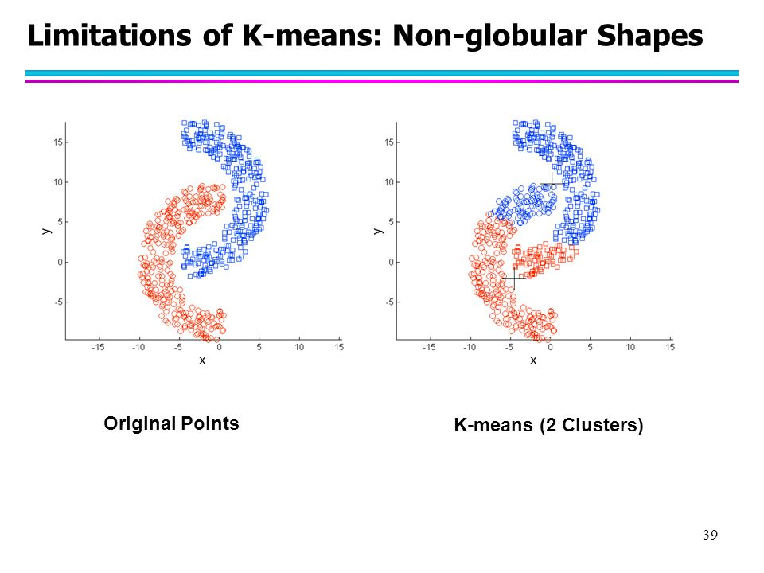
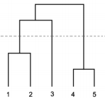
Background
Clustering a fundamental unsupervised learning problem
Performance depends on type of input data
Different similarity measures and separation techniques
Notes:
Goal of clustering is to separate data into clusters of similar data points
Applications
Automatic data labelling for supervised learning
Pre-processing step for data visualisation and analysis

Slide 4

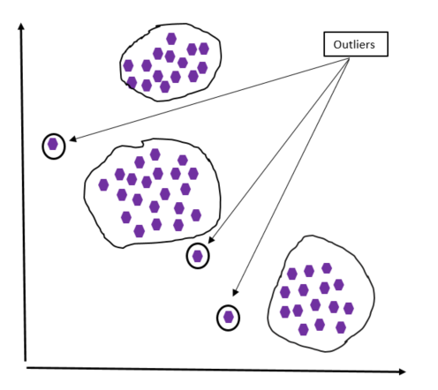
Why is clustering useful?
Automatic data labelling for supervised learning
Pre-processing step for data visualisation and analysis
Outlier detection
Notes:
-Look for the material that relates clustering and outlier detection

Slide 5
How good is a cluster?
1.Representative [occurs frequently enough]
2.Discriminative [different enough]
Notes:
1) to be representative, they need to occur frequently enough in the visual world;
2) to be discriminative, they need to be different enough from the rest of the visual world.

Slide 6
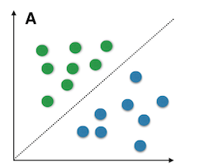
A clustering example - KMSVM
CLASS 1
H
CLASS 2
Clustering almost preserves the underlying structure and distribution of the original data
Notes:
KMSVM
K-means clustering is run on the 2-dimensional data set and 2 clusters are formed, C1, C2, …, C6. H is the classifier separating two-class samples into Class1 and Class2
http://www.cs.uvm.edu/~xwu/Publication/IJBIDM-05.pdf
The quality of clustering results depend on the data distribution

Slide 7
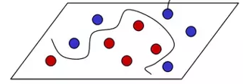
Can we build a linear classifier for this distribution?
YES?
NO?

Slide 8
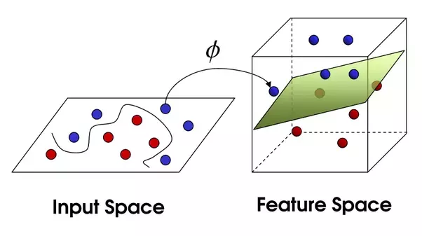
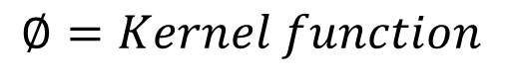
Discriminative clustering
$$∅=Kernel function$$
Notes:
https://www.quora.com/What-is-the-relation-between-SVM-kernels-and-CNN-kernels
Using linear SVM classifiers to compute more discriminative and robust clusters
Kernels: Make linear models work in nonlinear settings By mapping data to higher dimensions where it exhibits linear patterns Apply the linear model in the new input space Mapping ≡ changing the feature representation

Slide 9
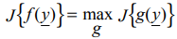
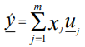
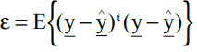
Non-linear mapping
Transform y of d-dim feature space to x of m-dim projected space where m<d
For PCA the approximation y,
A natural criterion for unsupervised learning is to mimimise mean square error
Notes:
Let’s get a little bit mathematical – let’s understand why this works
Linearly separable data is data that can be classified into different classes by simply drawing a line (or a hyperplane) through the data. In cases where data is not linearly separable, kernel trick can be applied, where data is transformed using some nonlinear function so the resulting transformed points become linearly separable
https://medium.com/@vivek.yadav/how-neural-networks-learn-nonlinear-functions-and-classify-linearly-non-separable-data-22328e7e5be1
a mapping f transforms a pattern y of a d-dimensional feature space to a pattern x of an m-dimensional projected space, m<d, such that a criterion J is optimized. The mapping f(y) is determined amongst all the transformations g(y). The mappings differ by the functional forms of g(x) and by the criteria they have to optimize
http://www.ee.bgu.ac.il/~boaz/ICPR13Lerner1996.pdf

Slide 10
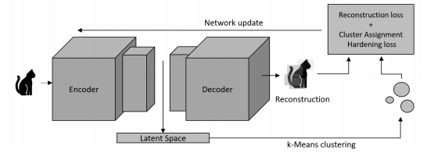

Clustering with deep learning
Losses
+
Cluster assignment
Dimensionality reduction / Representation learning
Aljalbout, E. et al. 2018. Clustering with Deep Learning: Taxonomy and New Methods.
Notes:
https://xifengguo.github.io/papers/ICONIP17-DCEC.pdf
We perform a non-linear mapping from the data space to a lower-dimensional feature space where we optimise the clustering objective
Dimensionality reduction / representation learning has been used to map input data into a feature space where separation is easier with respect to the problem’s context

Slide 11
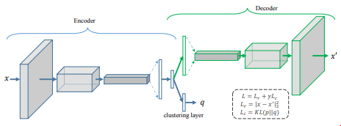
Deep embedding
Losses
Dimensionality reduction / Representation learning
Notes:
https://xifengguo.github.io/papers/ICONIP17-DCEC.pdf
We perform a non-linear mapping from the data space to a lower-dimensional feature space where we optimise the clustering objective

Slide 12
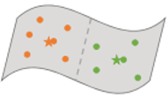
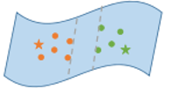
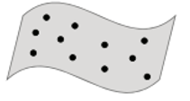
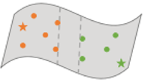
Different clustering techniques
1. Raw data space
2. K-means clustering
3. Discriminative clustering (linear SVM classifier)
4. Clustering with deep learning
A
B
C
D
Notes:
Unsupervised Deep Learning of Mid-Level Video Representation for Action Recognition
(a) The input data for clustering. (b) K-means minimize the within-cluster distance in an iterative fashion for clustering. (c) Using linear SVM classifiers to compute more discriminative and robust clusters (Singh, Gupta, and Efros 2012). (d) Based on (c), embedding a CNN with softmax loss to learn features from clusters (Huang, Chen, and Tang 2016). The learned features become closer in the same cluster, but the data space is unknown. (e) Our method learn discriminative clusters, and draw features into Euclidean space

Slide 13
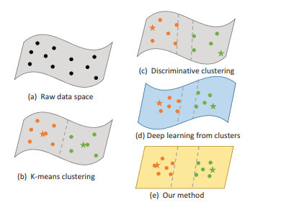
Techniques to aid clustering
Clustering with deep learning
Target method

Slide 14
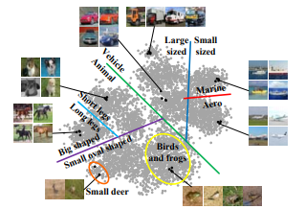
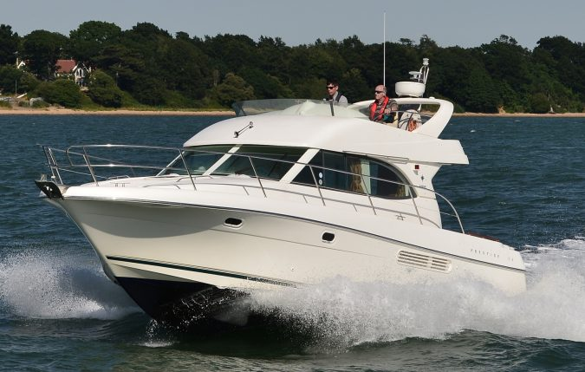
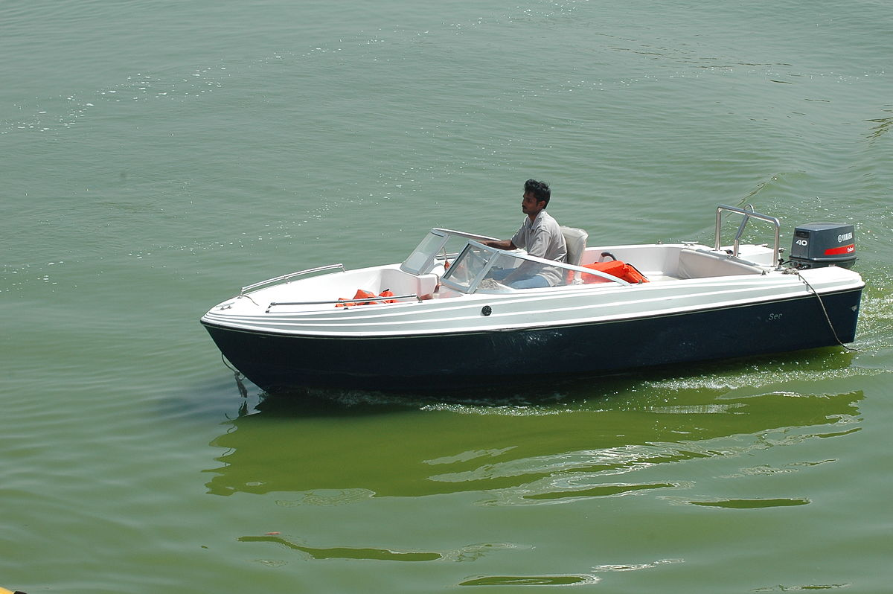
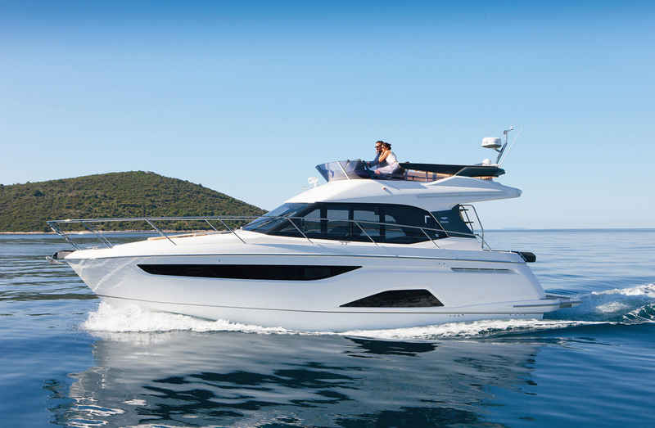
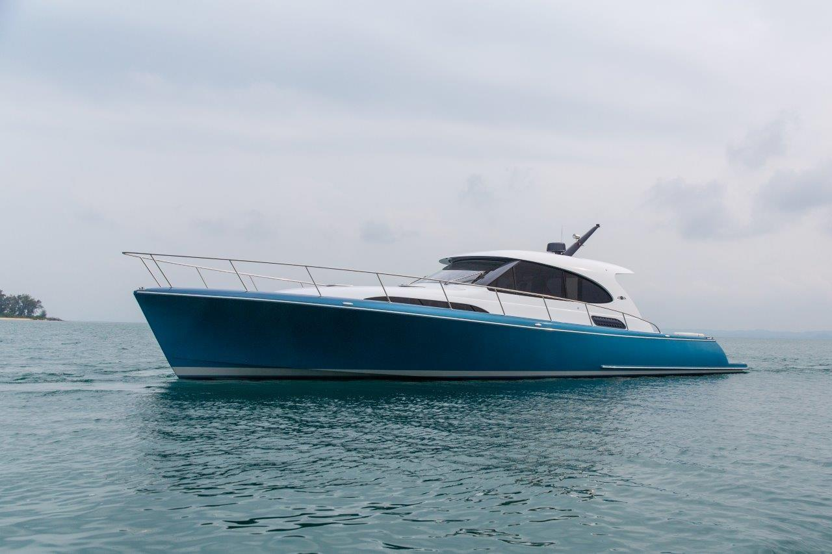

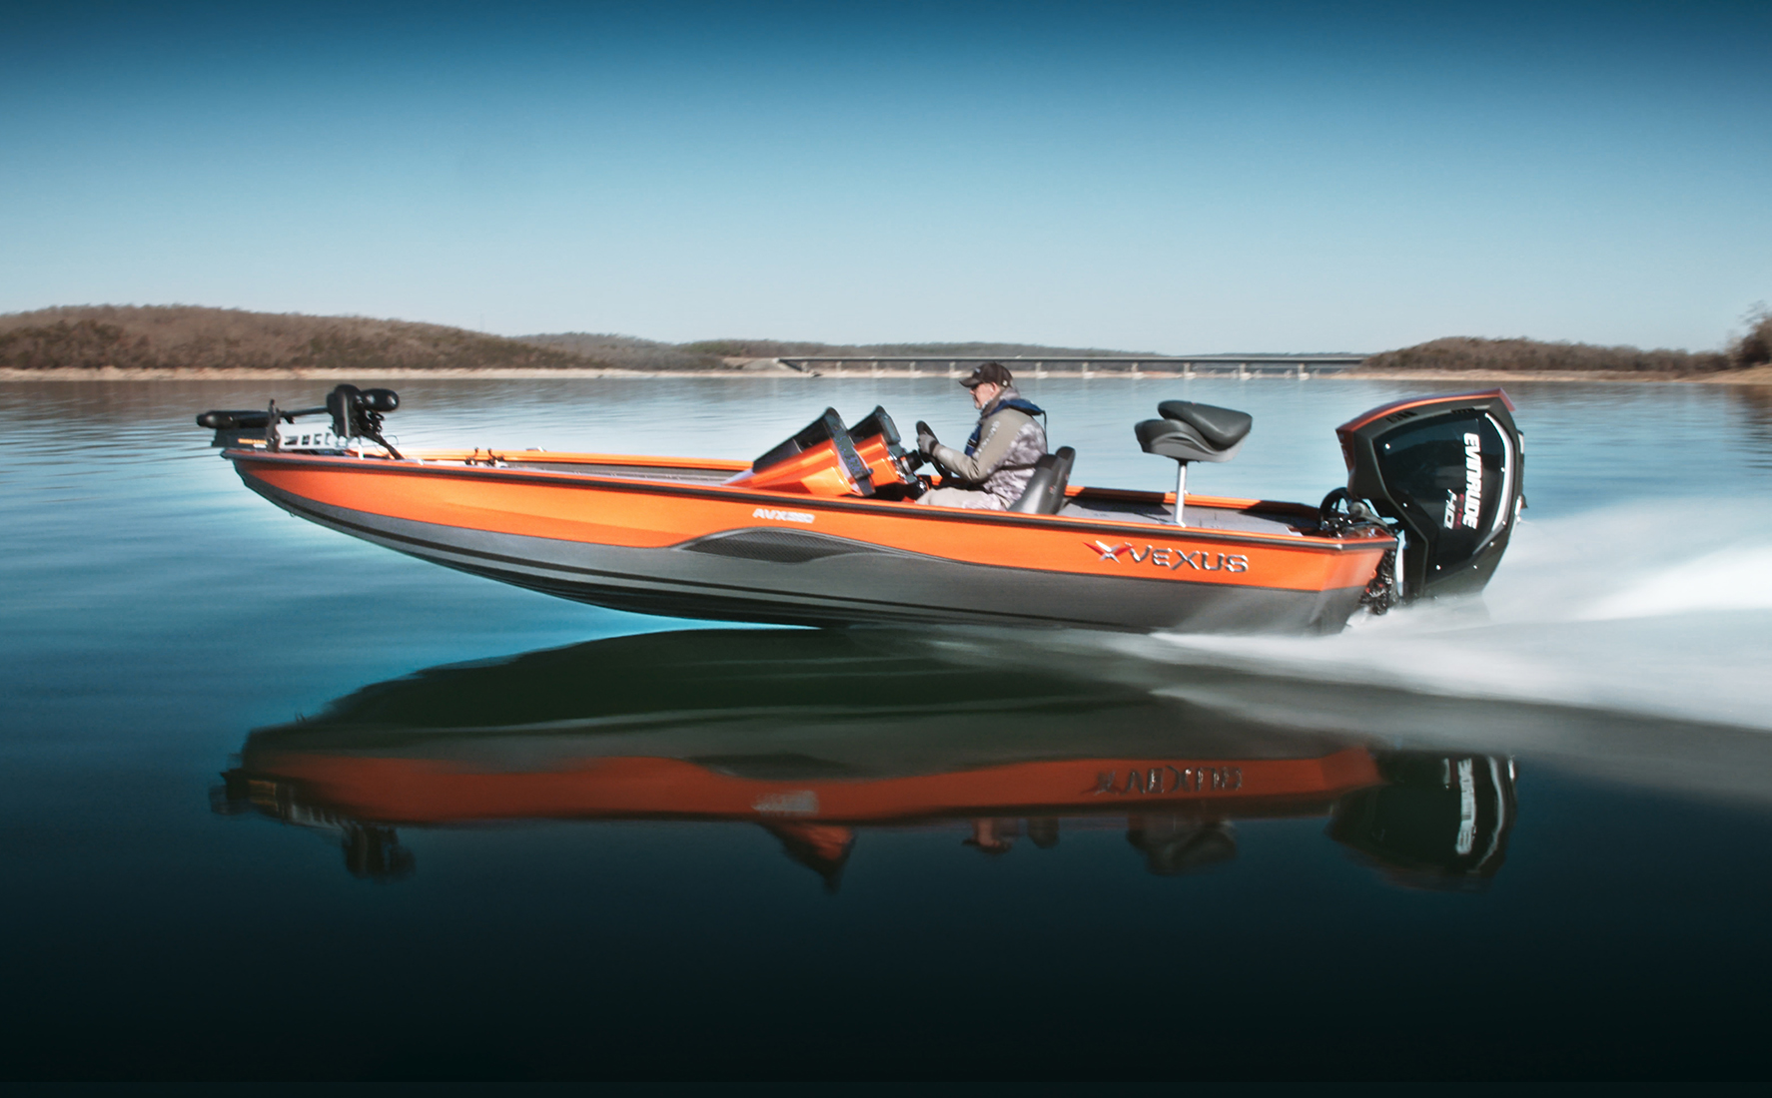
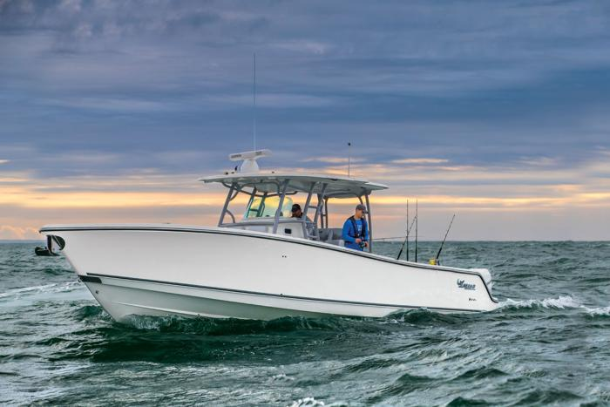
Image grouping – search and retrieval
Results
Query
Result
Huang et al. (2016). Unsupervised learning of discriminative attributes and visual representations
Notes:
http://personal.ie.cuhk.edu.hk/~ccloy/files/cvpr_2016_unsupervised.pdf

Slide 15
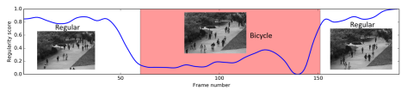
Towards real-time anomaly detection
Chong, Y.S. and Tay, Y.H., (2017). Abnormal event detection in videos using spatiotemporal autoencoder
Limited practicality for real-world scenario
Training is done offline
Train on normal activity dataset to characterise normality
Normal = low RMSE score, Abnormal = high RMSE score
Single activity
How do we characterise activities in a truly unsupervised fashion?
Notes:
Limited practicality for real-world scenario
How do we characterise the activities in a truly unsupervised fashion?
The idea is that if you can characterise the activities, then through the pattern you could begin to see the data points that are outliers – dissimilar datapoints (doesn’t fall within the formed clusters)

Slide 16
Intuition behind deep clustering technique for anomaly detection
Sitting
Deep learning improves the discrimination
Less representative data points become possible anomalies
Walking
Standing
Notes:
The idea is that if you can characterise the activities, then through the pattern you could begin to see the data points that are outliers – dissimilar datapoints (doesn’t fall within the formed clusters)
Literature justifying the line of thought
Outliers are objects not located in the cluster

Slide 17
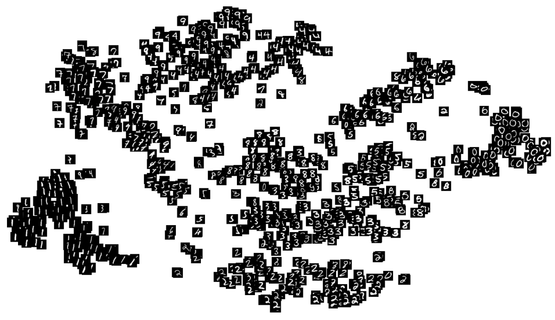
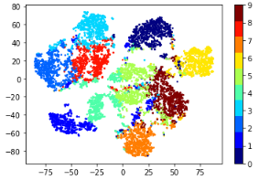
Initial investigation and open questions
Dim 2
Digits 0 to 9
Dim 1
MNIST
N=10
Analysis and improvement of deep clustering methods – Image dataset
Limitations: Uses predefined clusters
Requires prior knowledge of dataset structure [No of clusters]
How do we limit parameterisation for real-world applicability?
Notes:
How do we eliminate this predefined k-cluster assignment?

Slide 18
Key takeaways
Deep learning helps to improve the discriminability of clustering
How: non-linear mapping from data space to feature space
Why: dimensionality reduction
Applications: person re-ID and matching, object detection, tampering detection, image search and retrieval

Slide 19
Thank you!
Questions / Contributions?

